Slide 1

App Instructions

Slide 2
Logging on
Please note: You must be registered for Code Week in order to access the virtual platform and app. Only registered participants will have access.

Slide 3
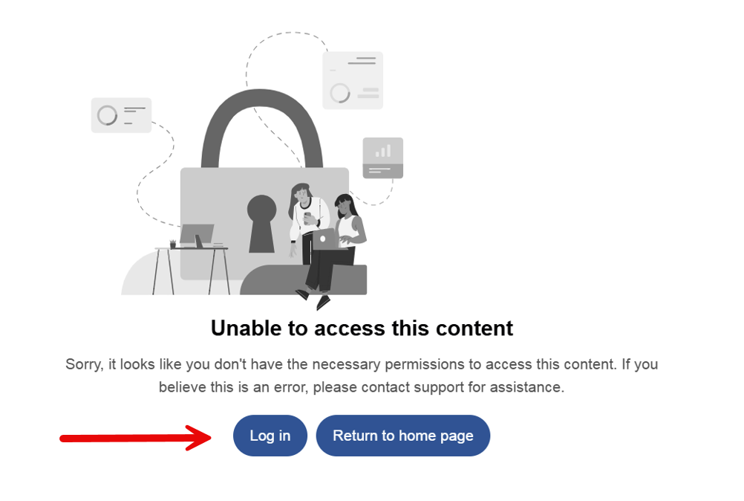
Visit this link
Click Log in
When prompted, sign in with the email address you registered with
Please note: You must be registered for Code Week in order to access the app.

Slide 4
Using the App

Slide 5
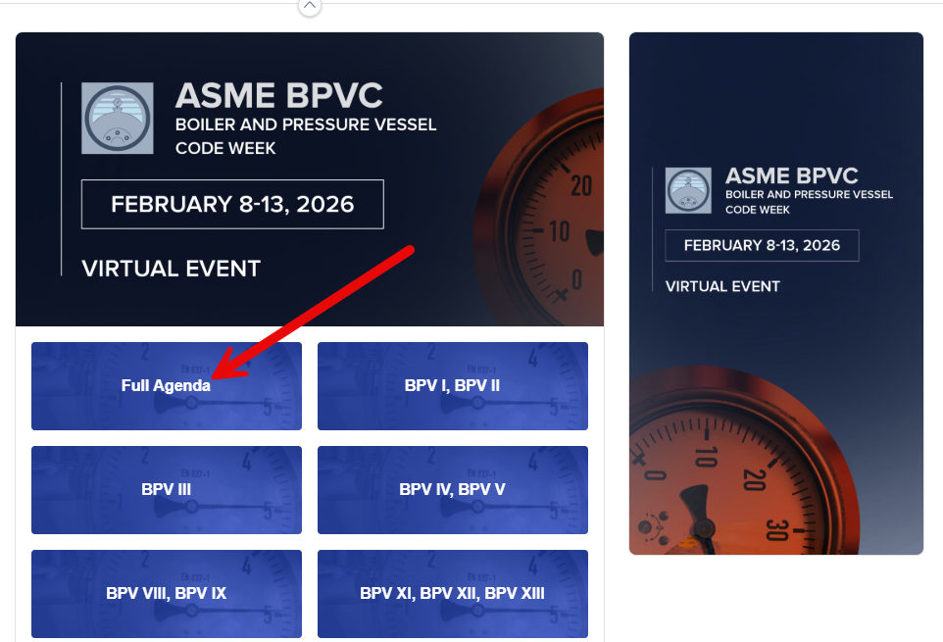
The ASME Conferences app contains everything you need to navigate Code Week successfully.
Find important information by tapping the various home screen buttons
All scheduled events are located in Full Agenda. Tap that button now.

Slide 6
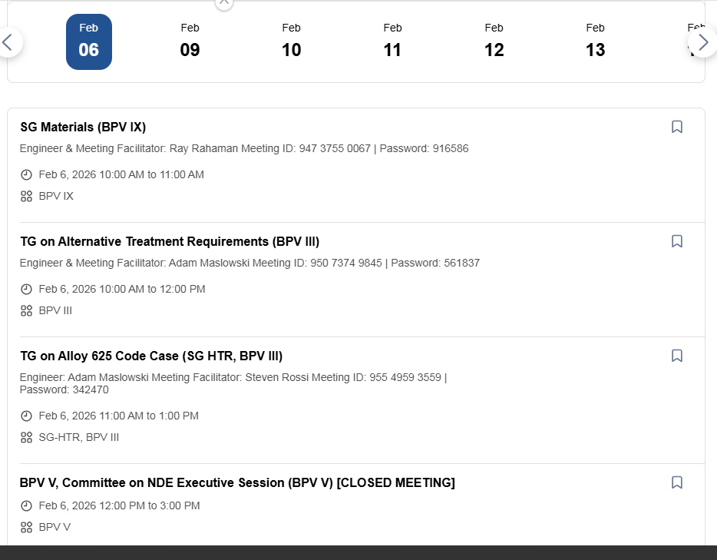
Full Agenda
Each schedule item includes:
Meeting time
Meeting location (when in person)
Meeting Category (BPV II, BPV VIII etc…)
Tap a schedule item to view Zoom information and meeting agenda.

Slide 7
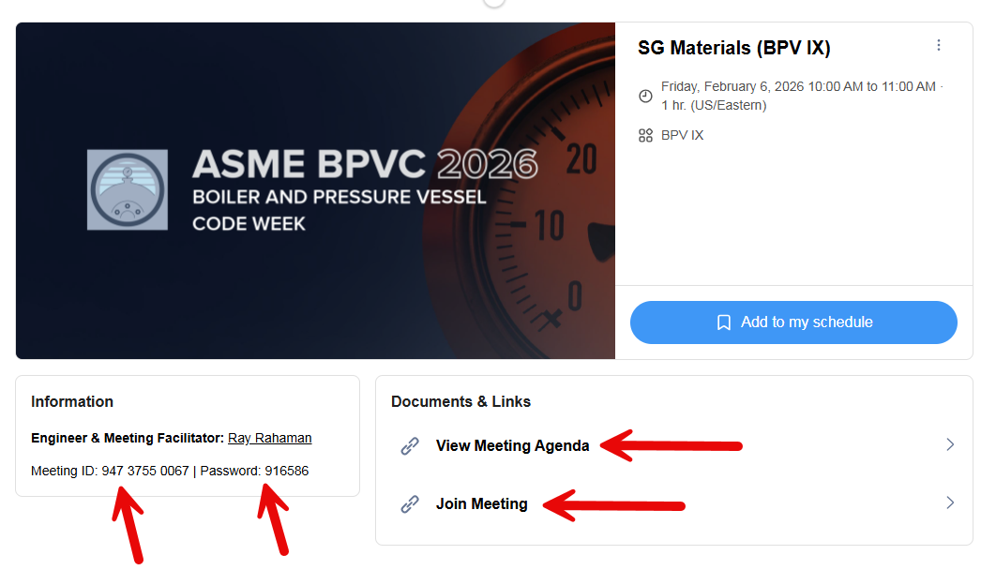
The links to view the meeting agenda and join the online meeting are shown here.
The meeting ID and password are also here.

Slide 8
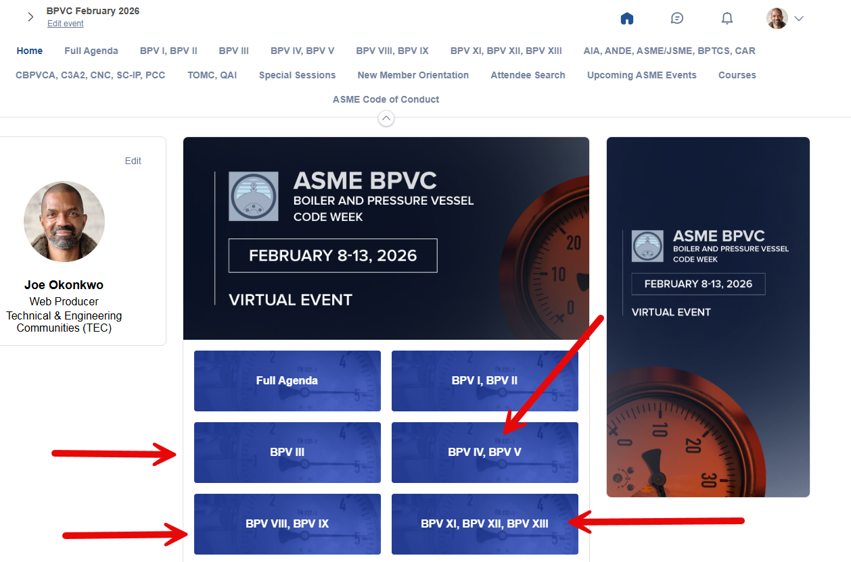
In addition to the Full Agenda, meetings are broken down and searchable by category.

Slide 9
Creating Your Own Agenda
Organize your schedule and optimize your time by adding events to your personalized agenda.

Slide 10
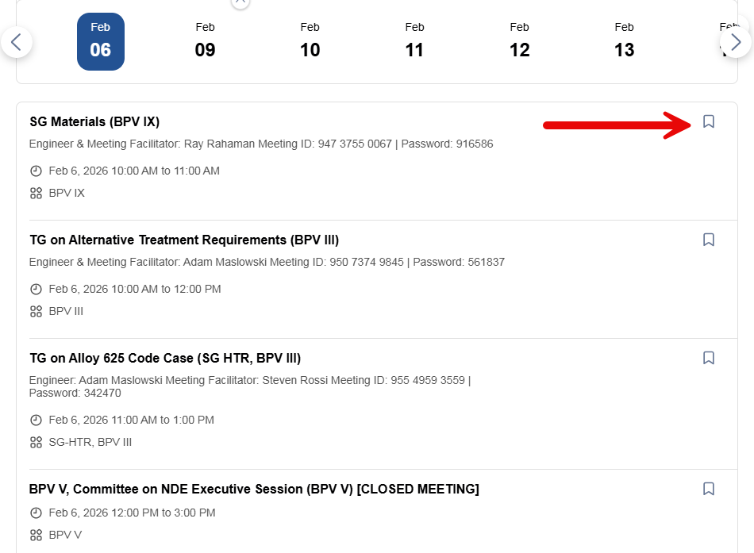
Click the bookmark icon next to the meeting.

Slide 11
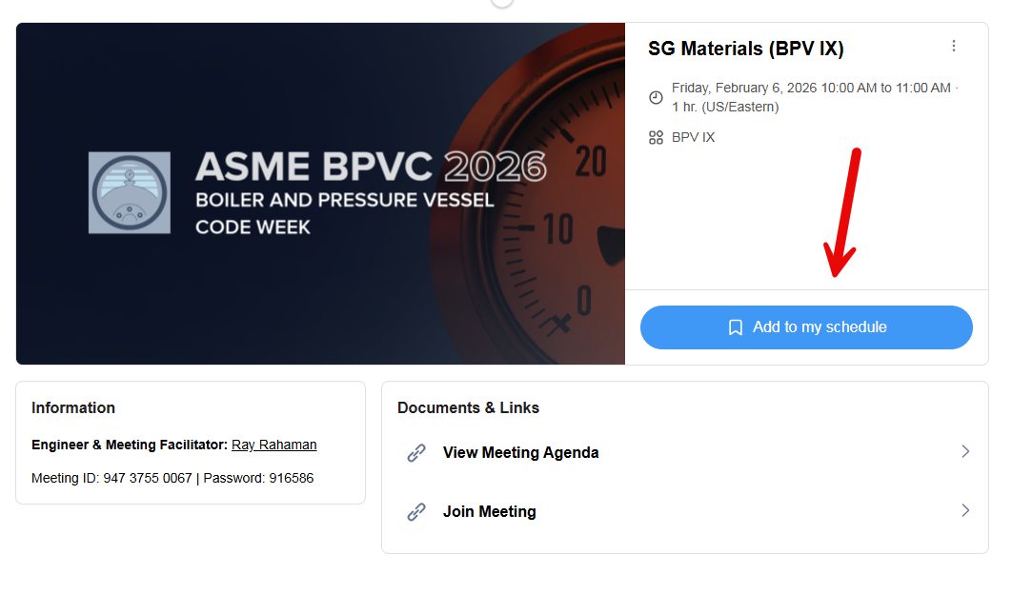
You can also tap Add To My Schedule on the detail page.

Slide 12
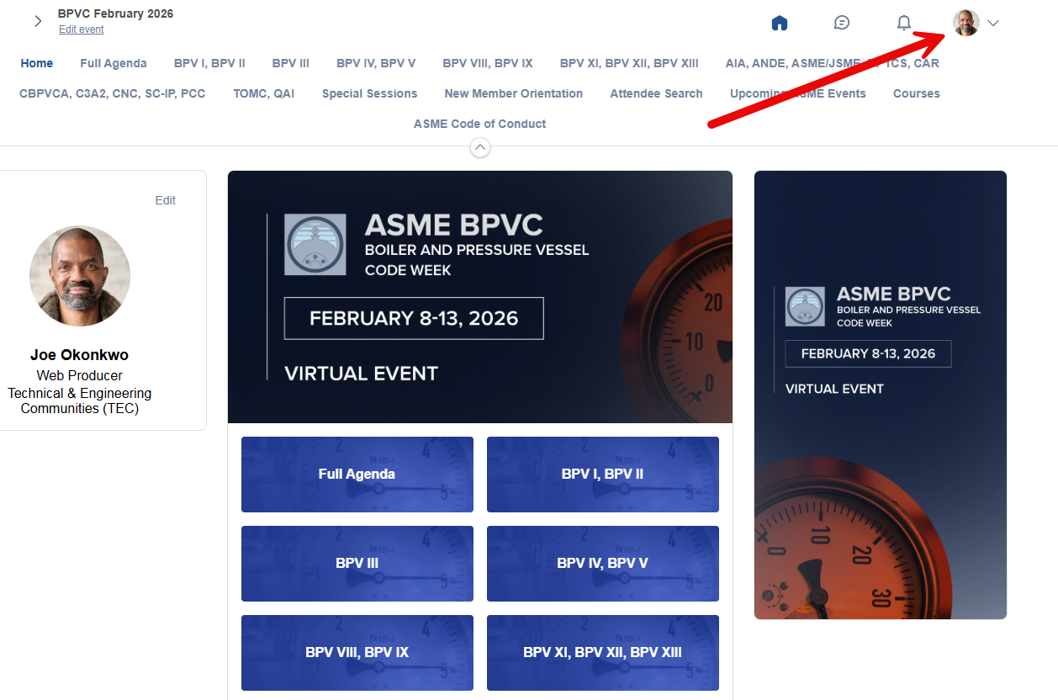
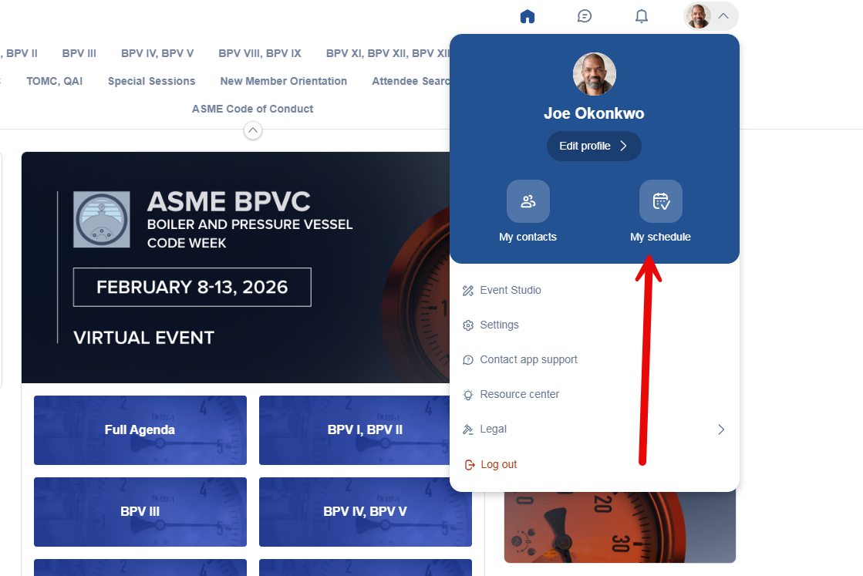
Add as many events to your schedule as you like. To view your personalized agenda, navigate back to the home screen, tap the profile icon, then tap My Schedule.

Slide 13
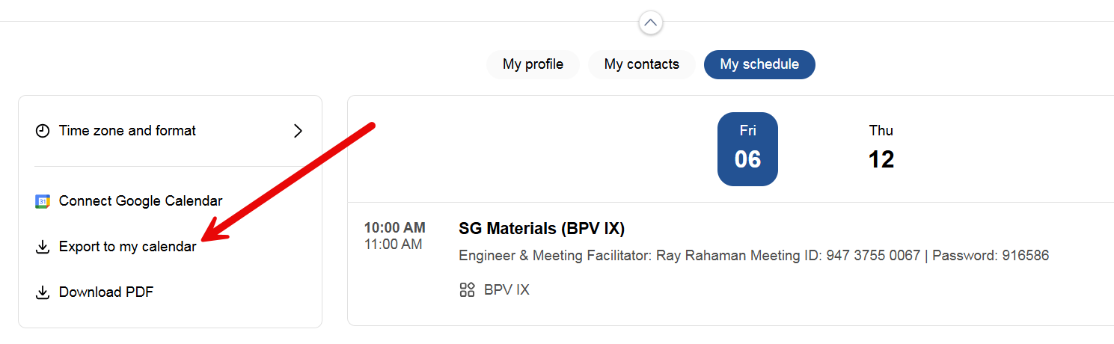
To download your saved sessions to a calendar (Outlook etc), tap Export to my Calendar and, follow the prompts.

Slide 14
Enjoy Code Week!

