Slide 1





Fundamental Hydrogen-Air Mixing, Combustion and Particulate Formation Processes in H₂ICE:
Particle Formation in Hydrogen Combustion
Leonid Tartakovsky
Director, Internal Combustion Engines Laboratory
Technion – Israel Institute of Technology
Collaborators: Andy Thawko, Ben Holtzer, Arnon Poran, Amnon Eyal
ASME ICED Webinar Series: The Future of the Internal Combustion Engine
December 13, 2023

Slide 2
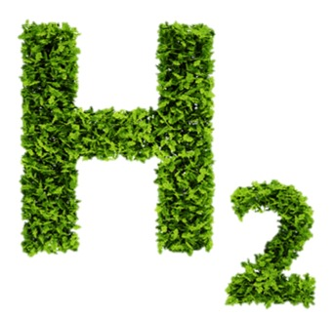
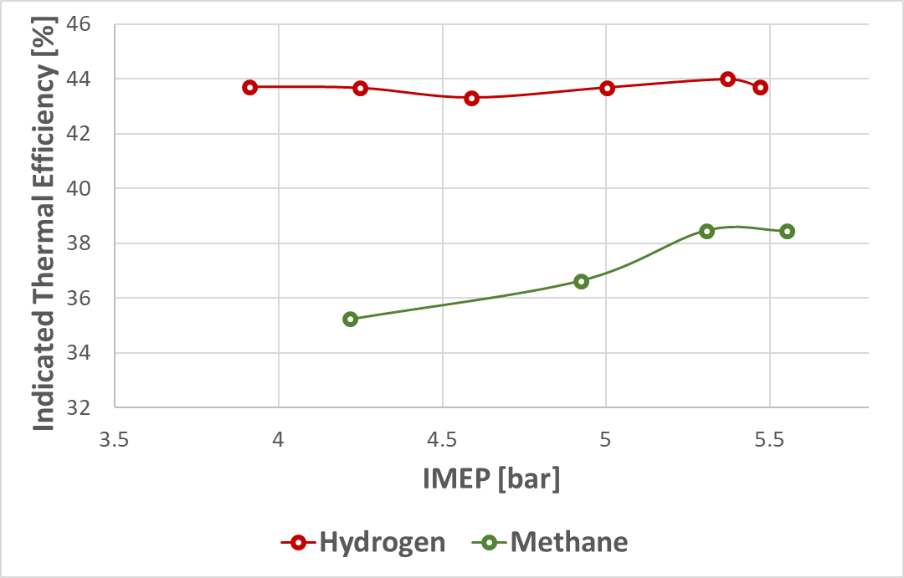
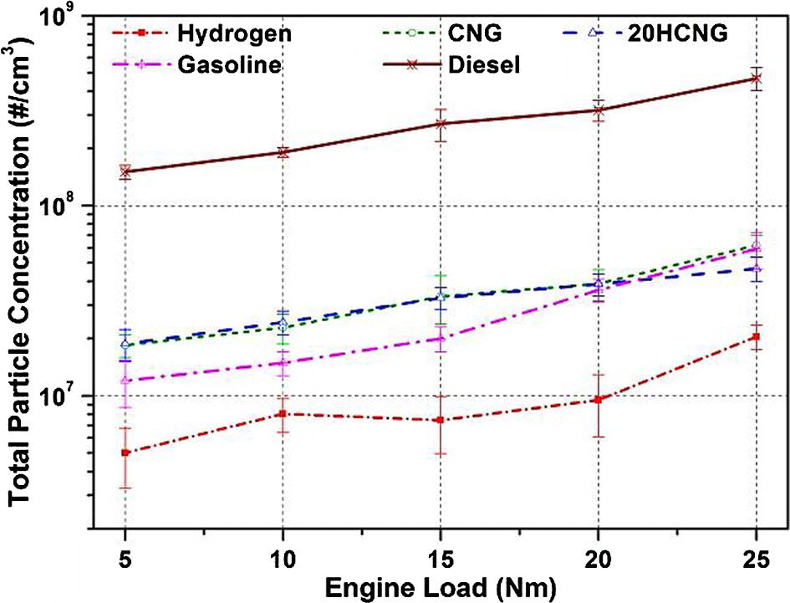
Hydrogen is a Great Sustainable Fuel for IC Engine
Carbon-free
Wide flammability limits
High burning velocity (207 cm/s vs ~35 for gasoline)
Contributes to better antiknock performance
Thawko et al., Energy Conversion & Management, 2022
Wide-spread opinion:
Carbon-free hydrogen combustion in IC engine should lead to performance improvement and emissions reduction
Singh et al., Fuel, 2016
2

Slide 3
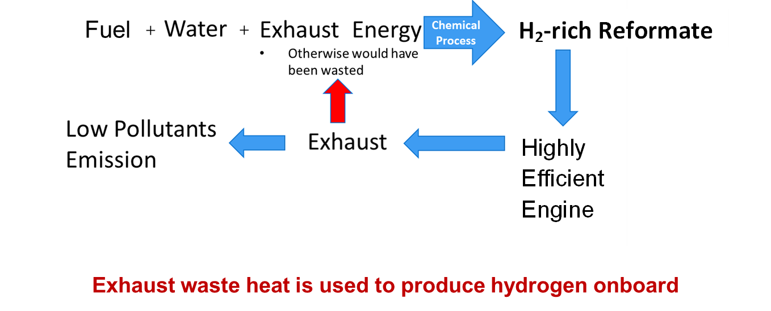
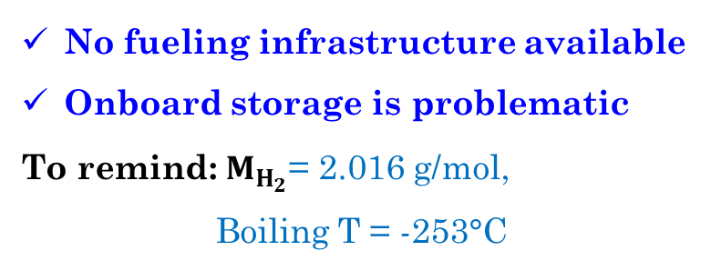
Challenges of Hydrogen as an ICE Fuel
No fueling infrastructure available
Onboard storage is problematic
To remind: $M_{H_{2}}$= 2.016 g/mol,
Boiling T = -253°C
Can be overcome through onboard on-demand hydrogen production
Because port reformate injection leads to abnormal combustion and power loss, we suggested employing the direct injection.
3

Slide 4
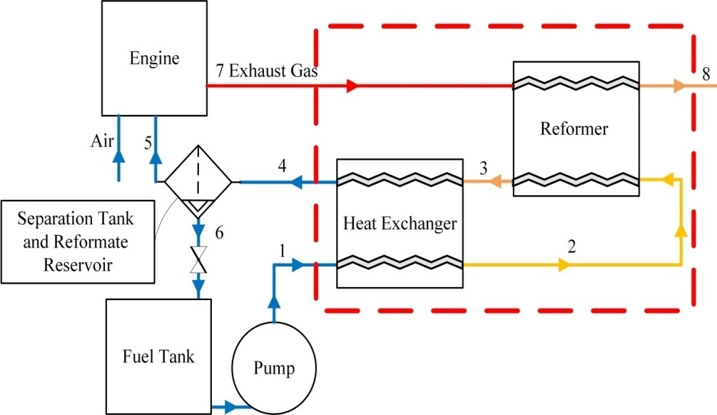
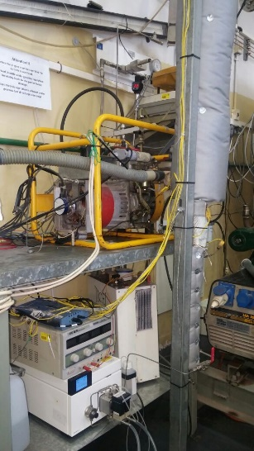
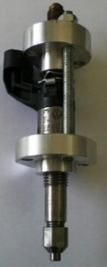
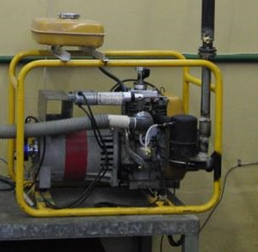
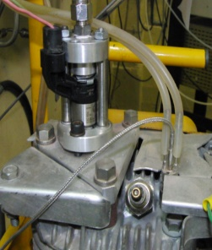
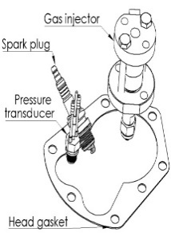
Onboard on-demand Hydrogen Production From a Sustainable Fuel
High-Pressure Thermo-Chemical Recuperation
Primary renewable low-carbon intensity liquid fuel (e-fuel)
Waste heat recovery process
Direct reformate injection
Hydrogen combustion
Ultra-low pollutant emissions
Thermo-Chemical Recuperation (TCR)
Methanol Steam Reforming (MSR)
CH₃OH+H₂O → 3H₂+CO₂ ΔH≈50 kJ/mol
Low reforming temperatures- 250-300 C
Tartakovsky L., Sheintuch M., Veinblat M., Thawko A., International Patent Application No. PCT/IB2020/056382, 2021
4

Slide 5
High-Pressure Thermo-Chemical Recuperation Performance
19%-30% relative increase in indicated efficiency
A reduction in NO_{x}, CO and HC emissions by up to 97, 91 and 96, respectively
Poran, Thawko et al., Int. J Hydrogen Energy, 2018
5

Slide 6
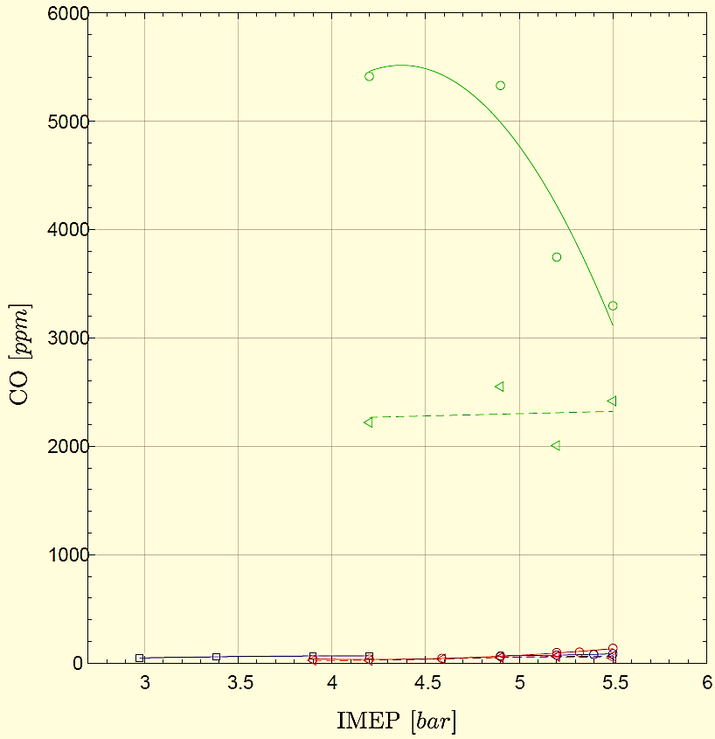
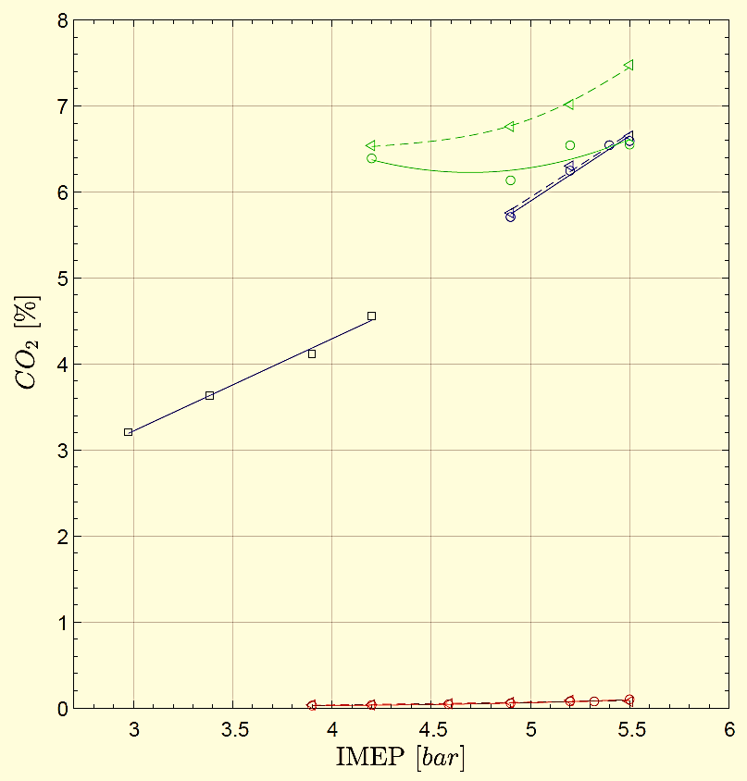
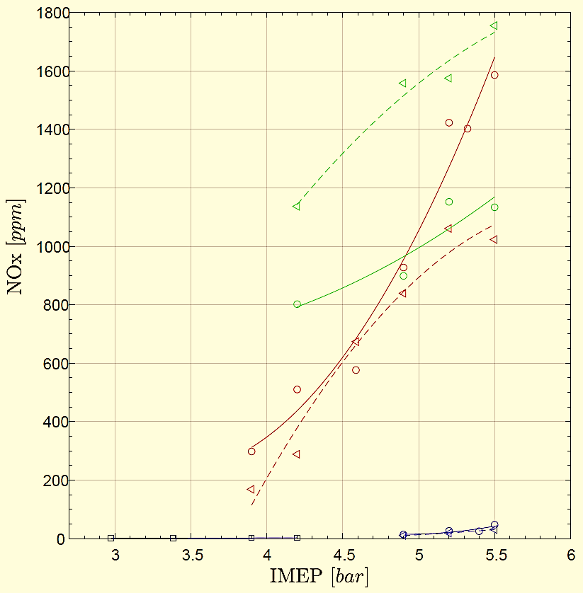
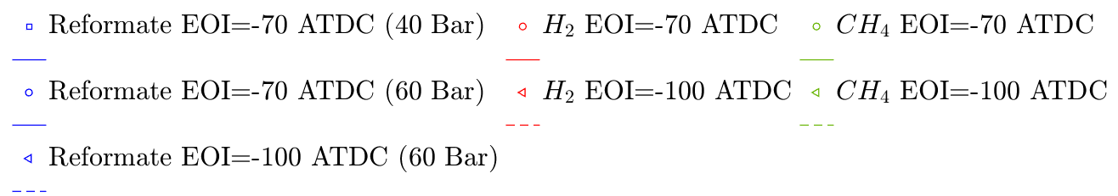
Fuel Type Effect on Gaseous Pollutant Emission – DI Engine
CO is near-zero for MSR and hydrogen
CO₂ for MSR - from the injected reformate
NO_{x} is near-zero for MSR due to CO₂
6

Slide 7
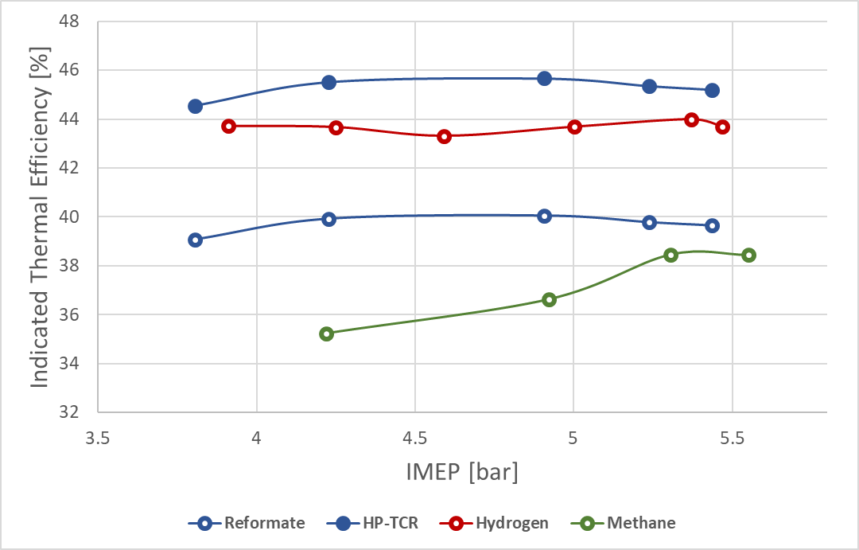
Fuel Type Effect on DI Engine Performance
HP-TCR system
HP-TCR system efficiency is higher than for the pure hydrogen
Ultra-low NO_{x} emission for the reformate due to CO₂ presence
Ultra-low CO emission for both the reformate and hydrogen
Advanced EOI is favored because of better fuel-air mixing
Thawko et al., Energy Conversion and Management, 2022
7

Slide 8
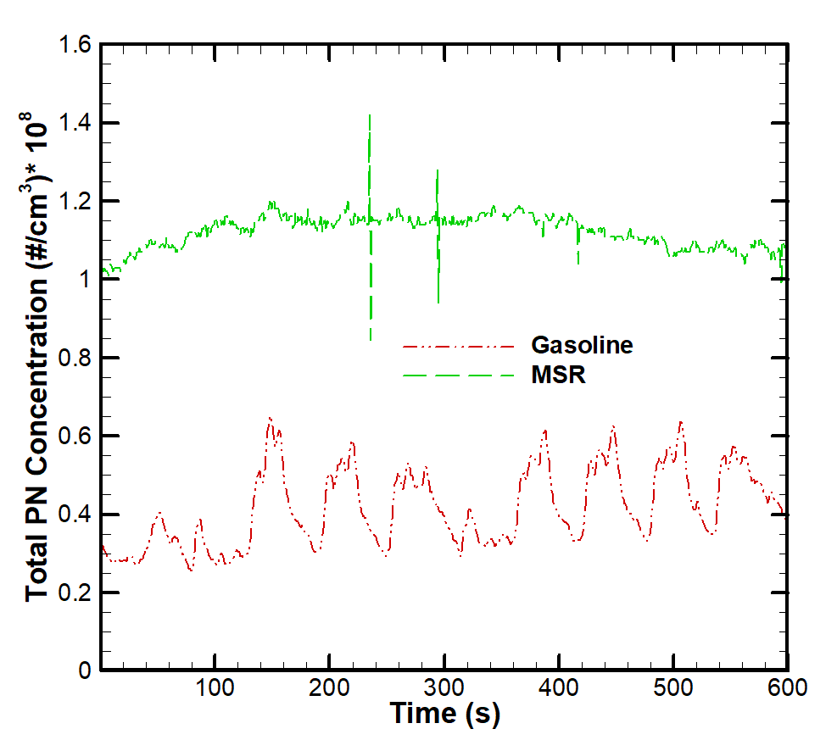
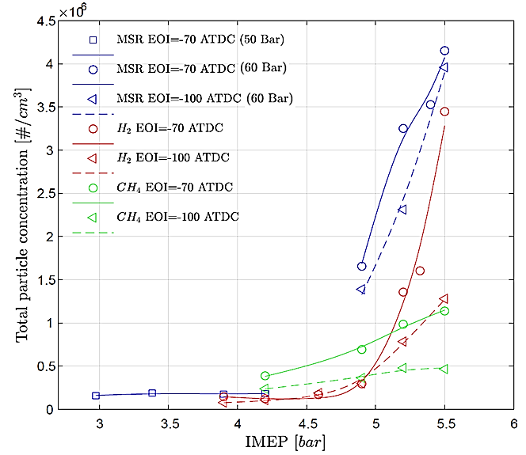
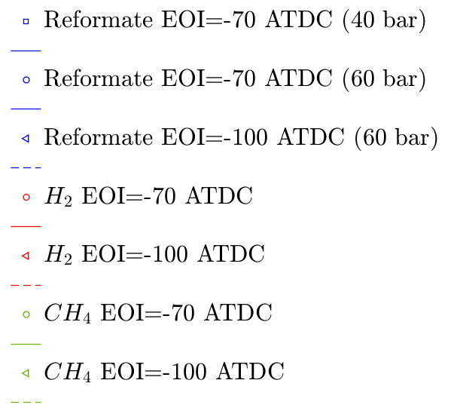
Total Particle Concentration Comparison
Thawko et al., Int. J Hydrogen Energy, 2019
Thawko et al., Energy Conversion and Management, 2022
MSR
CH₃OH+H₂O → 3H₂+CO₂
Previously Unknown Phenomenon
Why?
This result contradicts the previously published data and a straightforward intuition
8

Slide 9
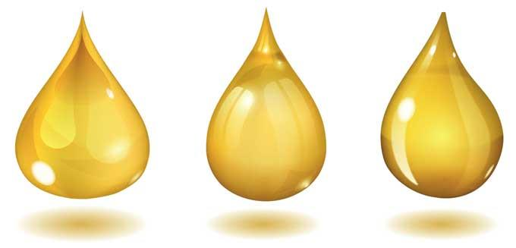
Particle Size Distribution – Different Oils
Higher PN concentration for all particle size with the reformate
PM were collected and characterized- lubricant additives were found
(a) Oil 1 (mineral)
(b) Oil 2 (synthetic)
Thawko et al., SAE Technical paper 2020-01-2200
9

Slide 10
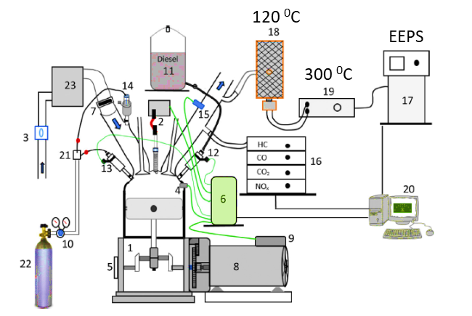
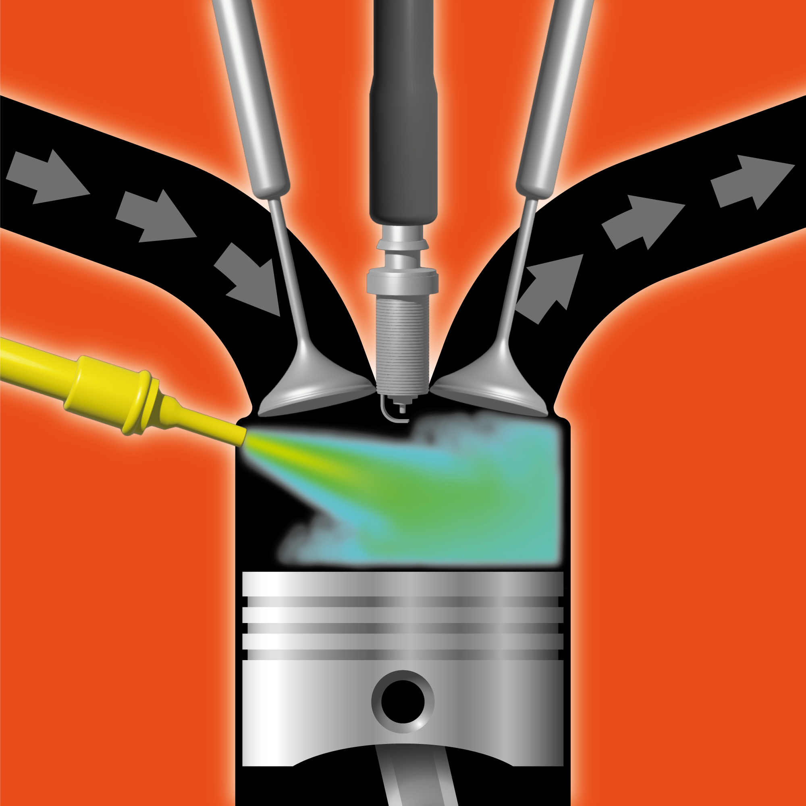

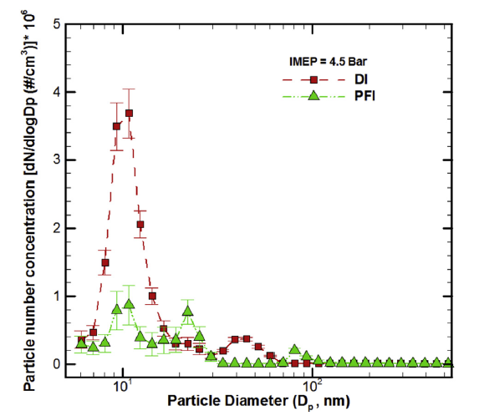
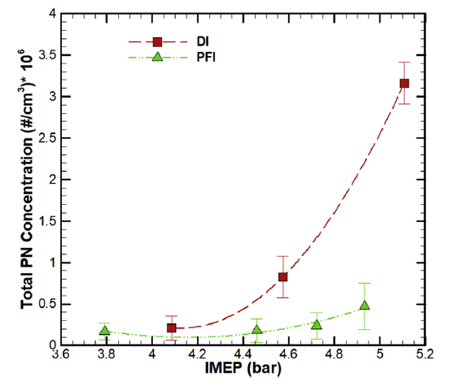
Particle Formation - Direct vs Port Fuel Injection
Single cylinder, Petter AD1 based
Bore x Stroke, mm | 80x73
Displacement, cm³ | 367
Compression ratio | 15-17.3
Power, kW @ speed, rpm | 5.3 @ 3000
Fuel injection system | Direct
 | Port
  Increased particles formation for direct injection
  Excessive lubricant involvement in the combustion
10

Slide 11
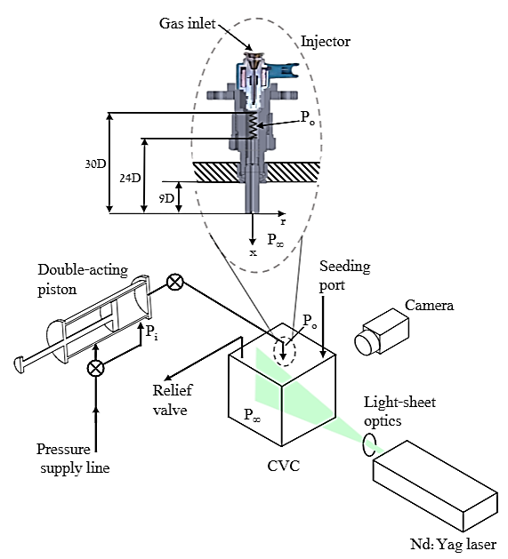
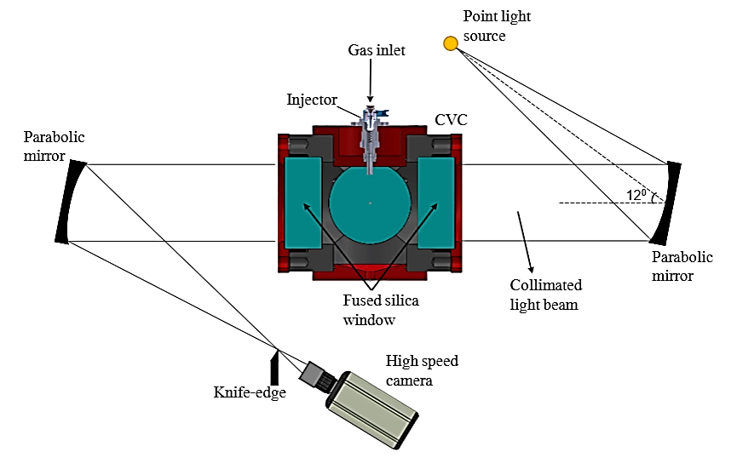
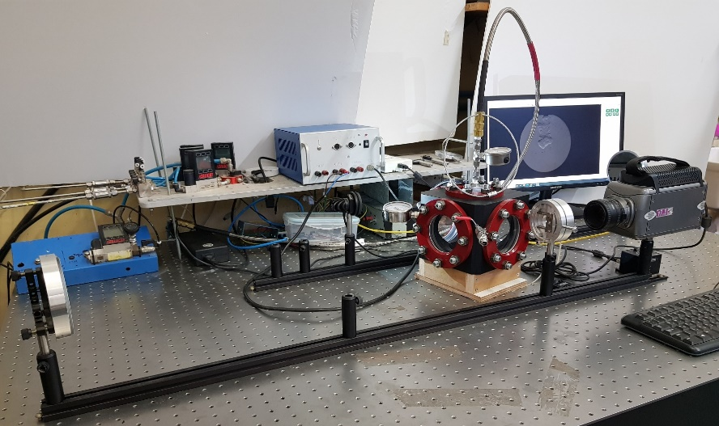
Under-expanded Gaseous Jet Flow Field
Fundamental investigation at ICE typical conditions
Goal:
  Study of the transient underexpanded gaseous jet
  Detailed flow field characteristics
Method:
  Schlieren & PIV technique for the near- and far-field characterization, respectively
Thawko et al., Physics of Fluid, 2021
11

Slide 12
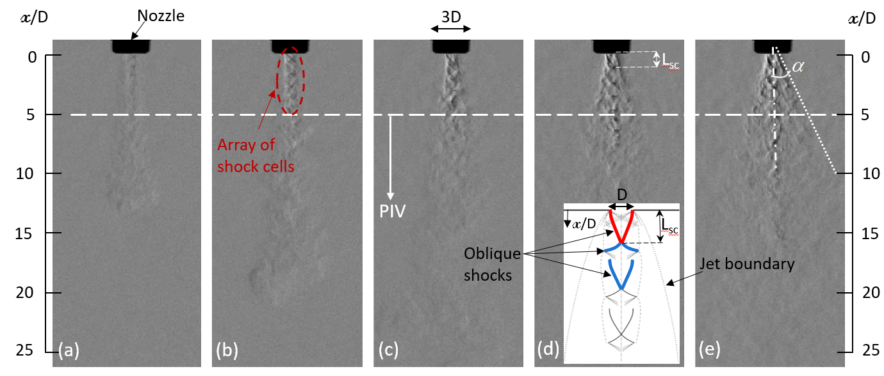
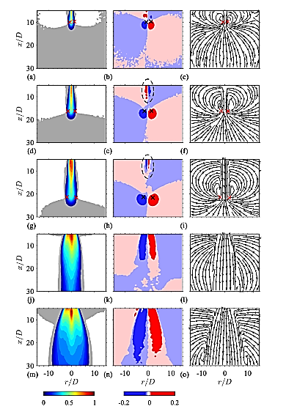
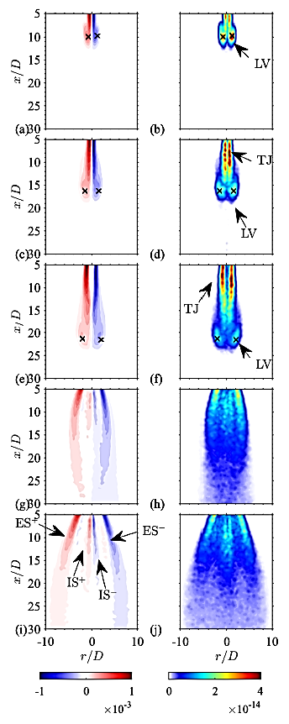
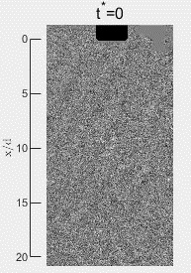
Flow Field Characterization- Free Flow Jet
Axial velocity
Radial velocity
Streamlines
Swirling strength
Vorticity
I
  Air entrainment encouraged by the transient under expanded jet
II
Thawko et al., Physics of Fluid, 2021
12

Slide 13
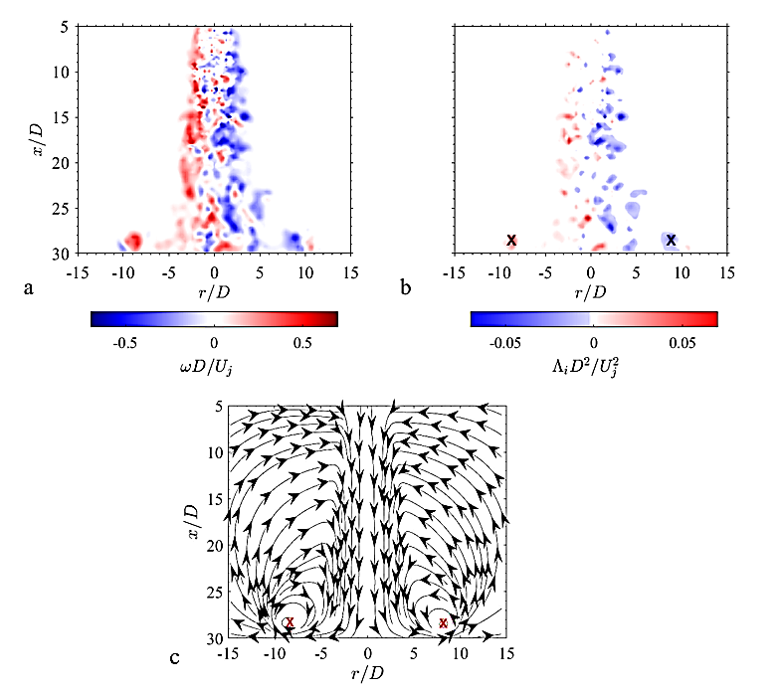
Flow Field Characterization- Impinging Jet
  Two rolled-up vortex regions with large-scale motion are formed in the wall jet region
  The lubricant vapor near cylinder walls entrained into the jet in the free-jet region and participates in the combustion
Vorticity
Swirling strength
Is this the main entrainment mechanism?
13

Slide 14
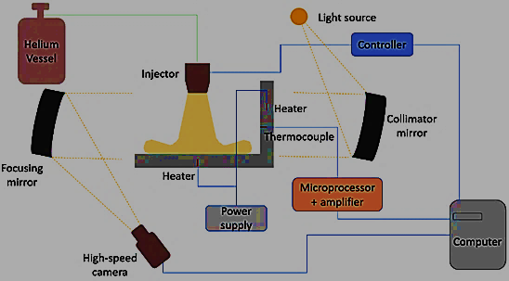
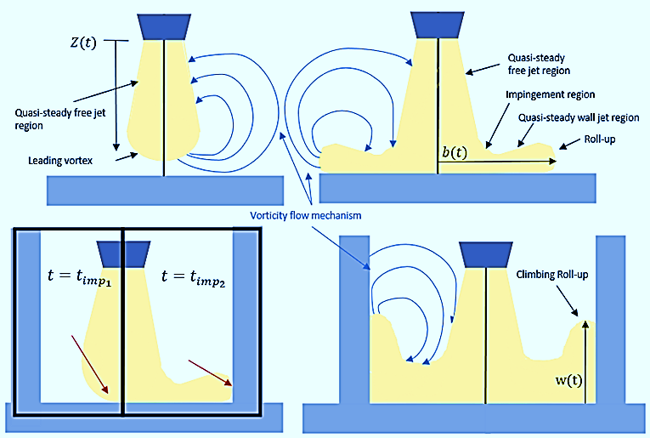
Interaction of a Gaseous Impinging Jet with a Heated Lubricated Surface
Several experiments were performed via Shadowgraph optical imaging Z-type configuration
  Perpendicular impinging jets were traced along the free, piston and liner jet regimes for further understanding of the entrainment mechanism
  The jets were injected onto heated piston and lubricated liner like surfaces to clarify the lubricant vapor entrainment phenomena
Holtzer & Tartakovsky, SAE Technical Paper 2023-01-0308, 2023
14

Slide 15
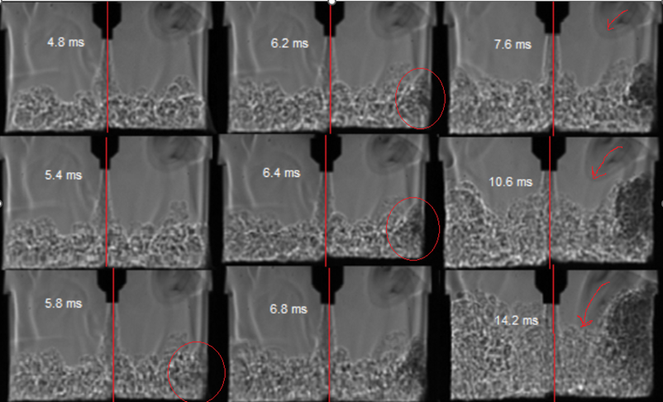
Main Lubricant Entrainment Mechanism
  Recirculation – entrainment of the lubricant vapor in the free-jet region
  Sweeping – entrainment of the lubricant vapor along the
  liner by the climbing roll-up
Sweeping is the main entrainment mechanism
Holtzer & Tartakovsky, SAE Technical Paper 2023-01-0308, 2023
15

Slide 16
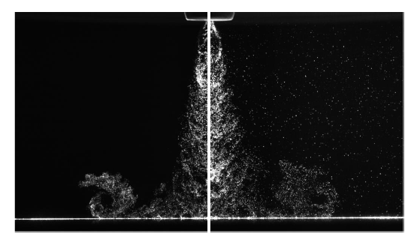
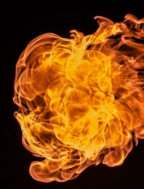
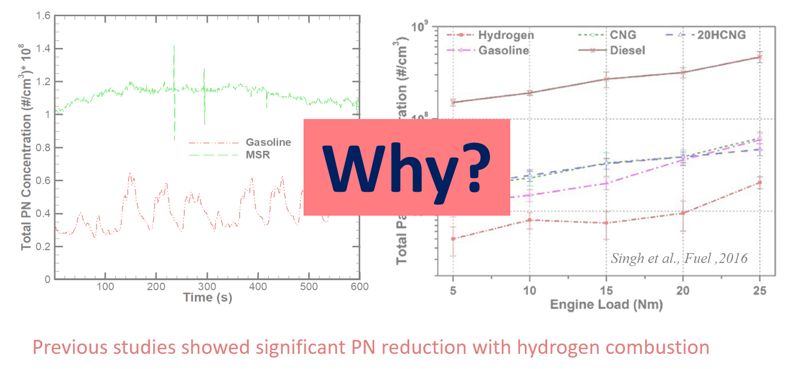
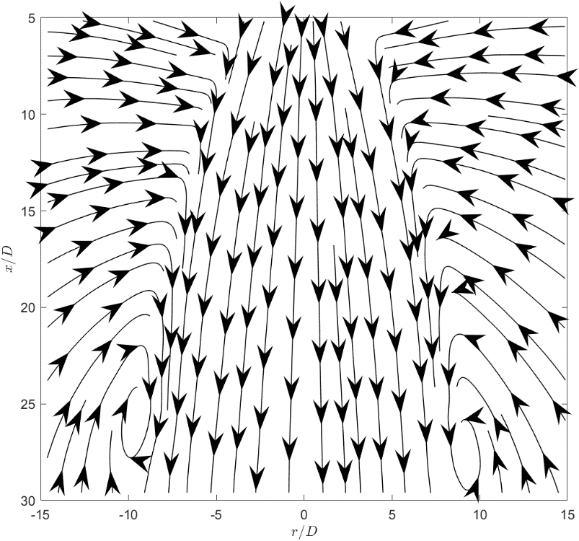
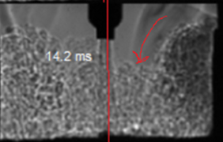
Particle Formation Mechanism in Non-premixed Combustion
Thawko & Tartakovsky, Fuel, 2022
Rogers et al. (2015)
Hydrogen low quenching distance
Both for DI&PFI
Excessive lubricant evaporation
Lubricant entrainment into combustion chamber bulk
Holtzer & Tartakovsky (2023)
Particle formation
16

Slide 17
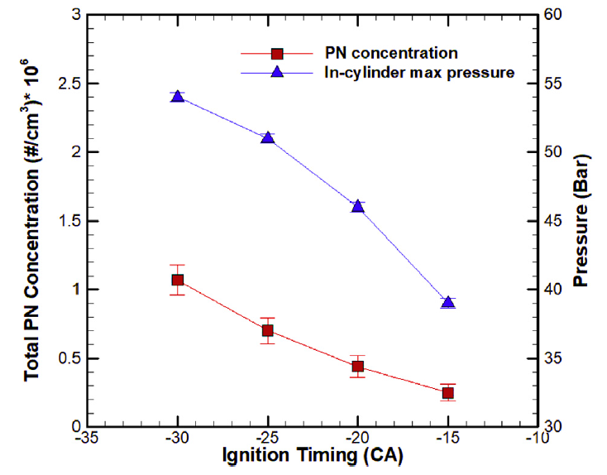
Particle Formation - Ignition Timing Effect
Reformate fuel
  Advanced ignition – increase in PN concentration
    Higher In-cylinder pressure followed by lower flame quenching distance
    More intensive lubricant evaporation
    More Lubricated surface exposed to flame
Thawko et al., Int. J Hydrogen Energy, 2019
17

Slide 18
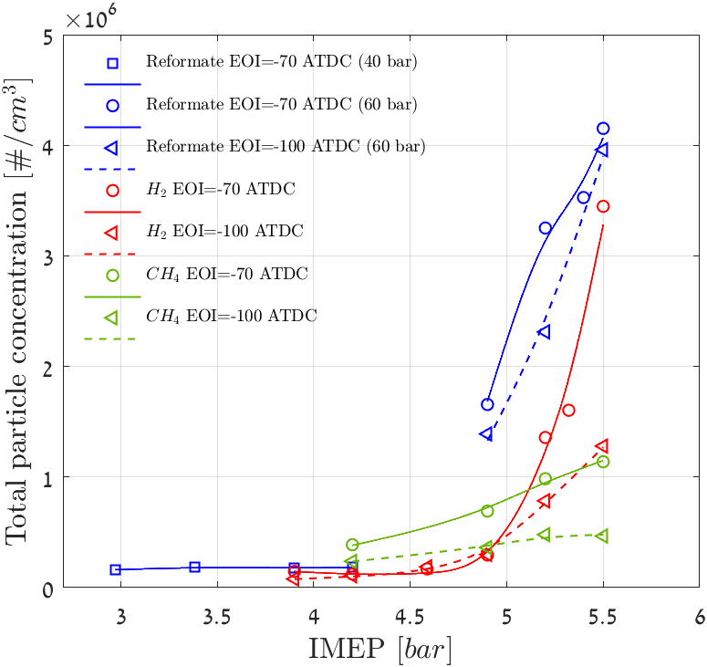
Non-premixed Combustion of Gaseous Fuel - Fuel Type Effect on Particle Emission
Thawko & Tartakovsky, Fuel, 2022
The fuel carbon content is the dominant influencing factor affecting particle formation at low loads
The lubricant becomes the dominant particle source with hydrogen-based fuel combustion
Reformate with the highest injection duration results in the highest particle formation
Thawko et al., Energy Conversion and Management, 2022
Particle Formation in a DI ICE
Flame Quenching Distance
Fuel Carbon Content
Injection Duration
18

Slide 19
Summary
Excessive particle formation was discovered in reformate/hydrogen combustion compared to hydrocarbon fuels
Particle formation mechanism in non-remixed hydrogen combustion was described
Sweeping is the main lubricant vapor entrainment mechanism into the combustion chamber bulk
Longer injection duration results in a higher particle formation
The described particle formation mechanism paves the way to development of novel engineering solutions aimed at particle formation mitigation
19

Slide 20





Acknowledgments
20

Slide 21

Q & A
Thank you for your attention!
Prof. Leonid Tartakovsky
tartak@technion.ac.il
21

